Slide 1






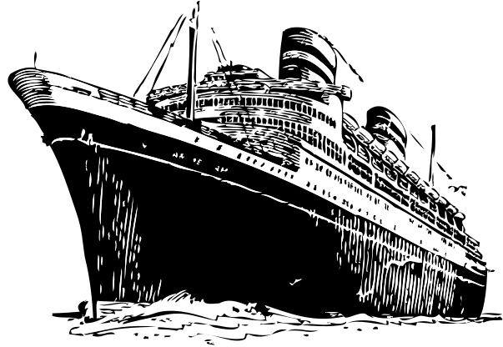




TITANIC SURVIVAL PREDICTION
MACHINE LEARNING

Slide 2

Ideation process
01
02
03
04
05
Introduction
Data Cleaning
Exploratory Data Analysis (EDA)
Data Modelling Comparison (Random Forest & Decision Tree)
Conclusion

Slide 3

Introduction
This Titanic’s dataset is more likely used to build predictive models to determine which passengers survived the Titanic disaster. The dataset includes passenger information such as age, gender, class, and fare, and many more allowing me to explore various factors that could have influenced survival. The goal is to use this data to create a machine learning model that accurately predicts survival outcomes. The machine learning model I have chosen, which is Random Forest, will be compared with the Decision Tree model. The model that is more accurate in modeling the safety of Titanic passengers will be determined through this comparison.

Slide 4
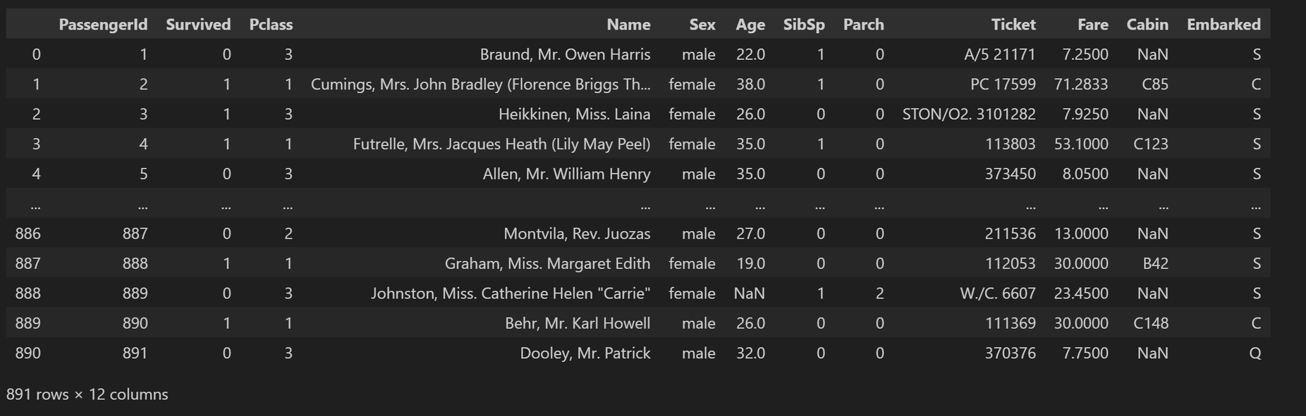
Data Overview
This machine learning model uses the Titanic dataset, which contains 891 rows and 12 columns

Slide 5
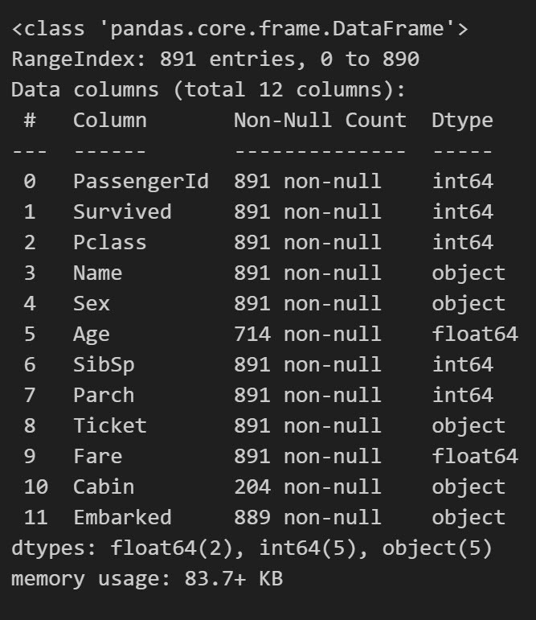



Data Info
The data in each column includes integers, floats, and objects. Some columns, such as Age and Cabin, have missing values. However, Cabin has significantly more missing values, so it may be possible to drop it.

Slide 6


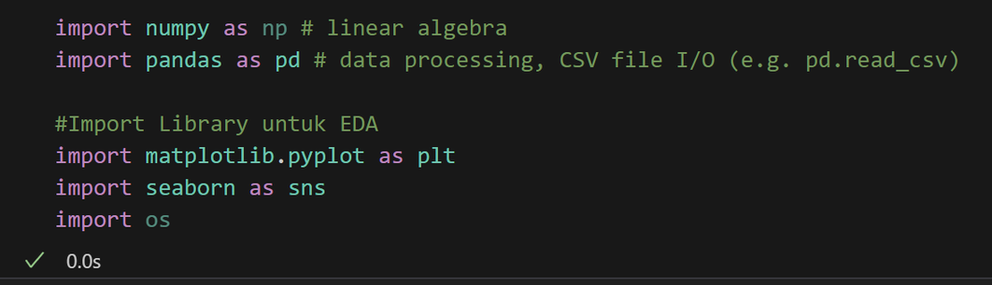
Library

Slide 7

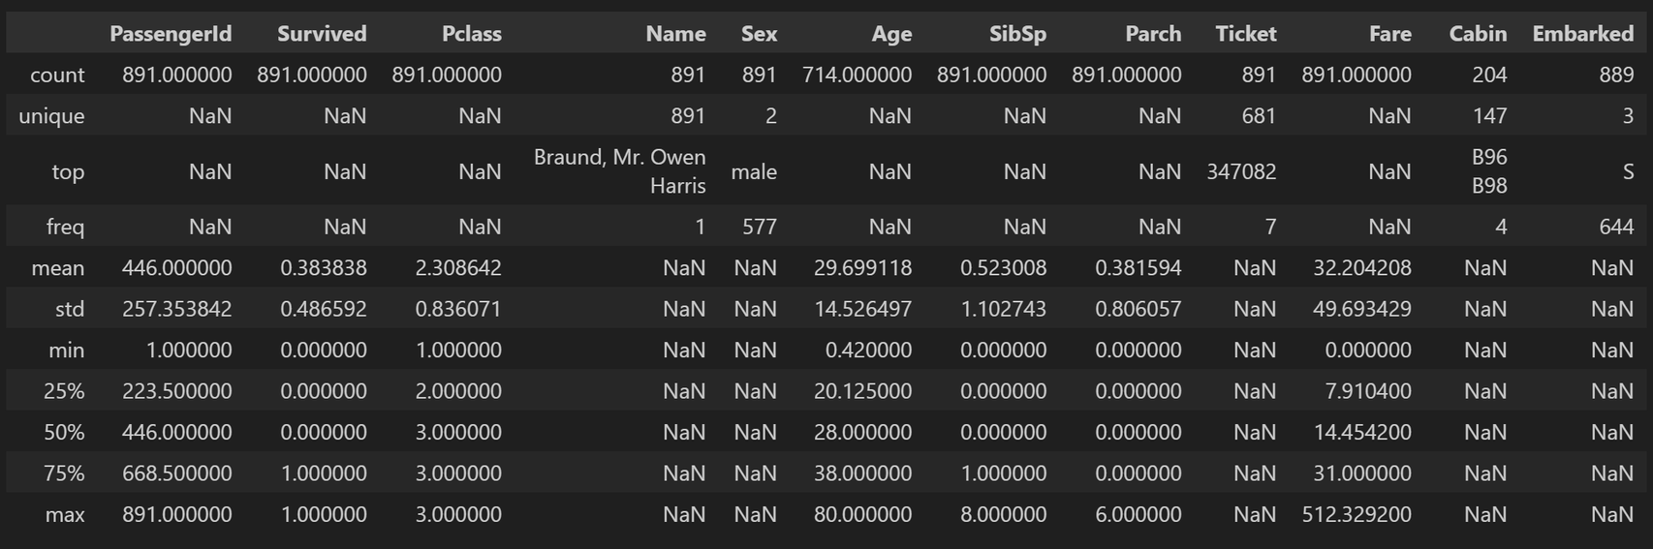
Descriptive Statistic
Descriptive statistics are used to summarize and describe the main features of a dataset. They provide simple summaries about the sample and the measures, giving an overview of the data distribution, central tendency, and variability. Common descriptive statistics include measures like mean, median, mode, standard deviation, variance, range, minimum, maximum, percentiles, and many more.

Slide 8
Data Cleaning

Slide 9

Data Cleaning Process
Checking for missing value
Filling missing values in the “Age” column with median
Filling missing values in the “Embarked” column with mode
Drop the “Cabin” column

Slide 10
Exploratory Data Analysis (EDA)

Slide 11
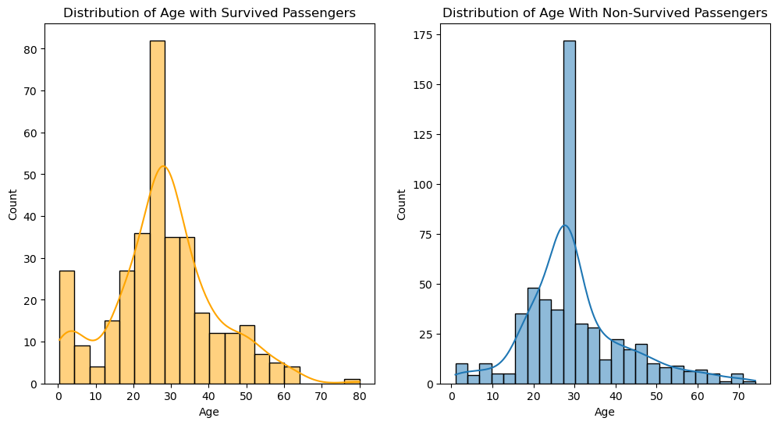
Create a Histogram to See the Distribution by Age of Survivors and Non-Survivors
These histograms are normally distributed.
Blue histogram represents the density of passengers who did not survive.
Orange histogram represents the density of passengers who survived.

Slide 12
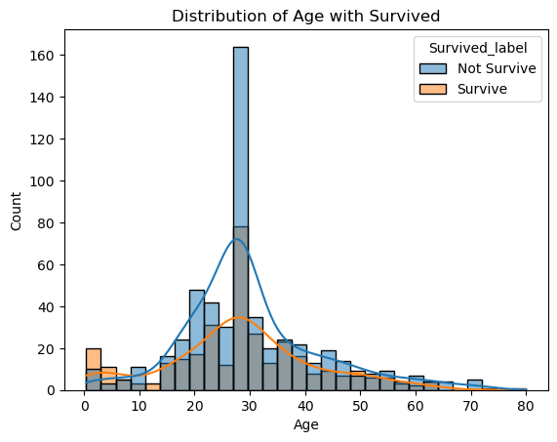
Combine a Histogram to See the Distribution by Age of Survivors and Non-Survivors
This histogram compares the survival and non-survival rates based on age. We can see the difference in these two histograms if we are combining them.
The highest blue bar at around age 30 indicates that most passengers who did not survive were around this age.
The highest orange bar on the left are Children and mostly under 10 years old.
Children were more likely to survive, possibly because they were prioritized for rescue.

Slide 13
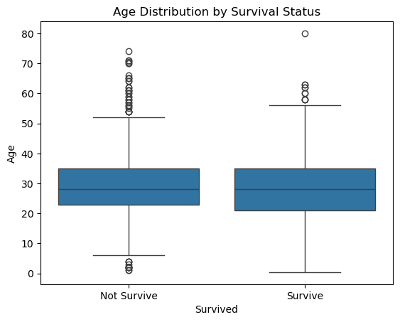
Create a Boxplot to See the Distribution by Age of Survivors and Non-Survivors
Boxplot with Survival Status:
The median age of passengers who survived is also around 28-30 years old.
The box area for survived is lower compared to those who did not survive.
The passengers who survived were in the age range of 0 - 60 years. Many young children, even toddlers and under 20 years old were also survived.
There are outliers above 50 years old, with some even reaching 80 years old.
Boxplot with Non-Survival Status:
The median age of passengers who did not survive is around 28-30 years old.
The box area for non-survival is higher compared to those who survived, which means a lot of middle-aged passengers were not survived .
The passengers who did not survive (considered outliers) include young children between 0-10 years old. There are also outliers above 50 years old, indicating that only a few passengers in that age range did not survive.

Slide 14
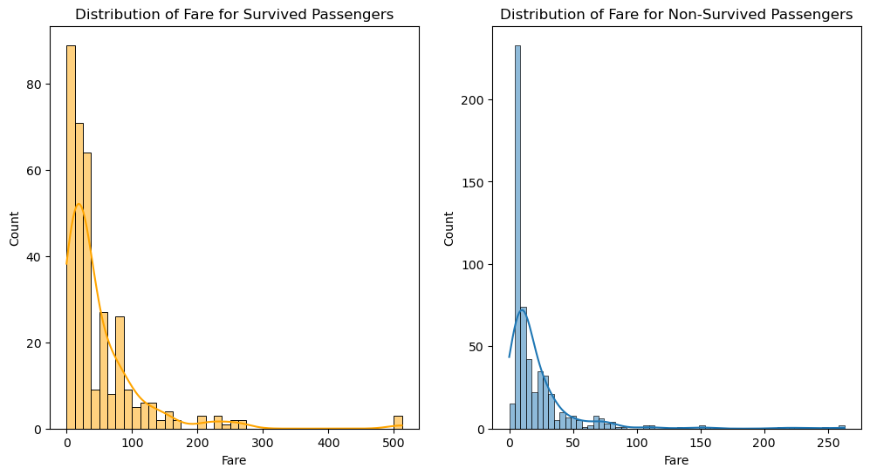
Create a histogram to see the distribution by fares of survivors and non-survivors
These histograms are right-skewed.
Blue histogram represents the density of passengers who did not survive.
Orange histogram represents the density of passengers who survived.

Slide 15
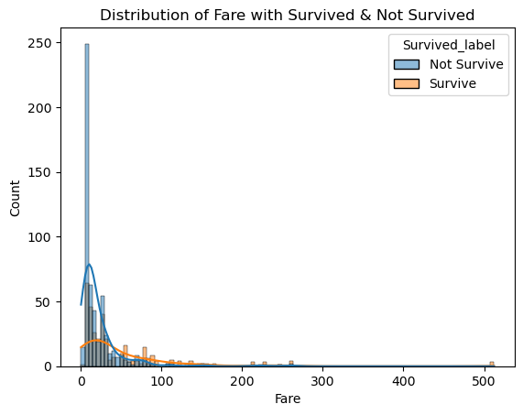
Combine a Histogram to See the Distribution by Fares of Survivors and Non-Survivors
This histogram compares the survival and non-survival rates based on fare. We can see the difference in these two histograms if we are combining them.
Most survivors paid lower fares (0 to 50 USD), but there is a broader range of fares extending up to 500 USD. This suggest that passengers with higher fares are more likely to survive compared to those with lower fares.

Slide 16
Create a Boxplot to See the Distribution by Fares of Survivors and Non-Survivors
Boxplot for Survived Status
The box area for Survived Passengers with higher fares tend to have a higher chance of survival. This is because, many passengers with expensive tickets survived in the boxplot. This can be seen from the higher median in the boxplot compared to those with lower fares.
The outliers indicate that many passengers who survived paid much higher fares.
Boxplot for Not Survived Status
Passengers with lower fares tend to have a lower chance of survival, as most of the fare values are concentrated at the lower end of the scale, close to 0.
Outliers in the not survived boxplot are found in the higher fare range. This means that fewer passengers with higher fares did not survive compared to those who did.
The median for lower fares shows that more passengers with lower fares did not survive.

Slide 17
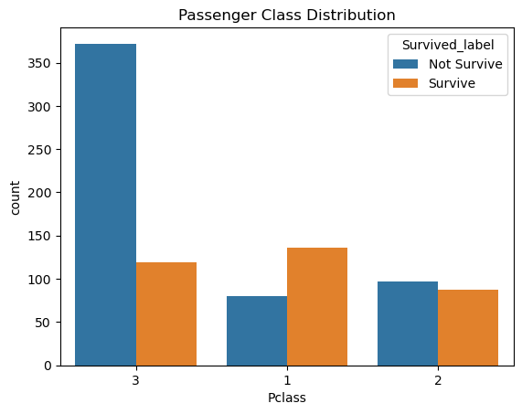
Histogram Distribution by Passenger Class of Survivors and Non-Survivors
The lower the Passenger Class, the greater the chance of passengers surviving. Conversely, the higher the Passenger Class, the greater the chance of not surviving.
This can also mean that the cheaper the Passenger Class, the higher the risk of passengers not surviving. The more expensive the Passenger Class, the greater the chance of survival.

Slide 18
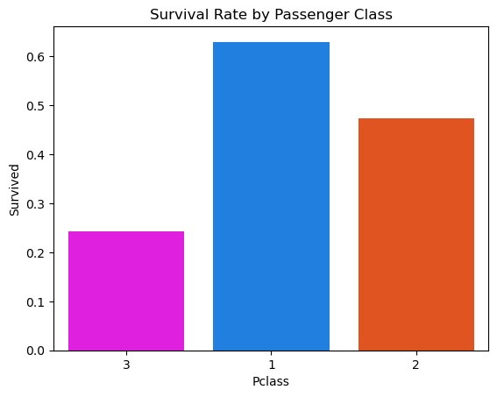
Histogram Distribution by Passenger Class of Survivors and Non-Survivors
Surviving passengers were more likely to come from higher classes, while non-surviving passengers were more likely to come from lower classes.

Slide 19
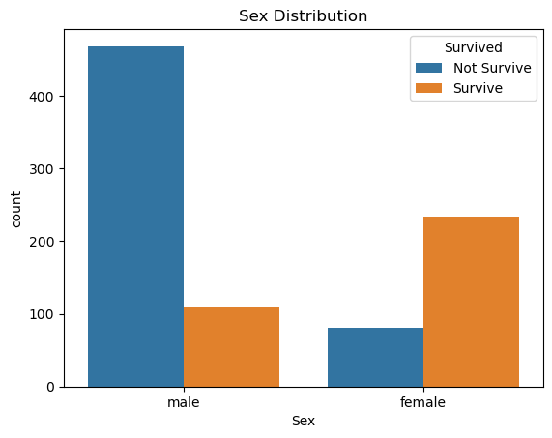
Histogram Distribution by Gender of Survivors and Non-Survivors
More male did not survive compared to female. This could be because female were prioritized for rescue.

Slide 20
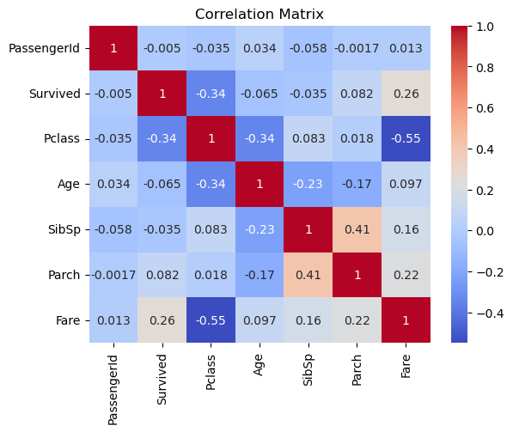
Correlation Matrix
The correlation between Pclass and Fare is negative. This means that the higher the fare, the lower the Pclass. The lower the passenger's class, the more expensive the fare. The result is negative because the correlation is inverse.
The lower the class, the higher the likelihood of survival.
In conclusion, Pclass is what influences whether a passenger survives or not.
The higher the passenger's fare, the greater the likelihood of survival.

Slide 21
Data Modeling Comparison (Random Forest vs Decision Tree)

Slide 22
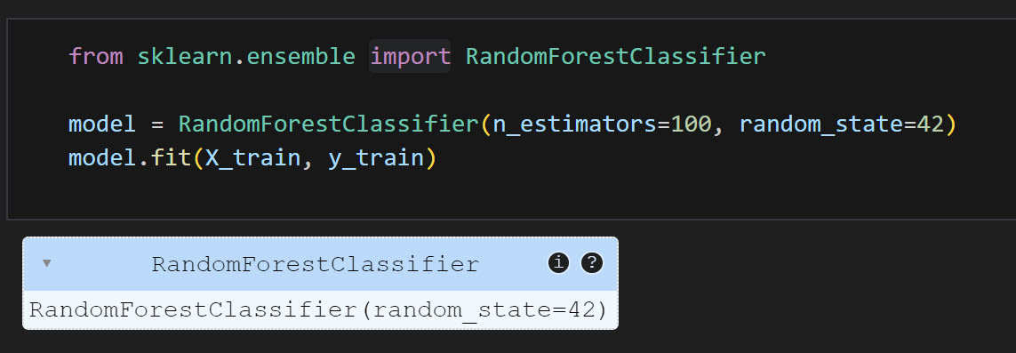
Random Forest Modeling
This parameter indicates the number of decision trees that the model will build. In this case, 100 decision trees will be constructed.
Similar to “train test split”, “random state” is used to ensure that the training results are reproducible. It ensures that the random selection in the decision tree-building process will be the same every time the code is run.

Slide 23
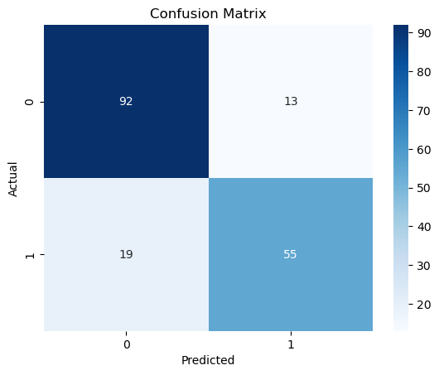
Random Forest Confusion Matrix
True Negatives (TN) - 92: The model correctly predicted 92 passengers as non-survivors, and they indeed did not survive.
False Positives (FP) - 13: The model incorrectly predicted 13 passengers as survivors when they did not survive.
False Negatives (FN) - 19: The model incorrectly predicted 19 passengers as non-survivors when they actually survived.
True Positives (TP) - 55: The model correctly predicted 55 passengers as survivors, and they indeed survived.
0 = Not Survive
1 = Survive

Slide 24
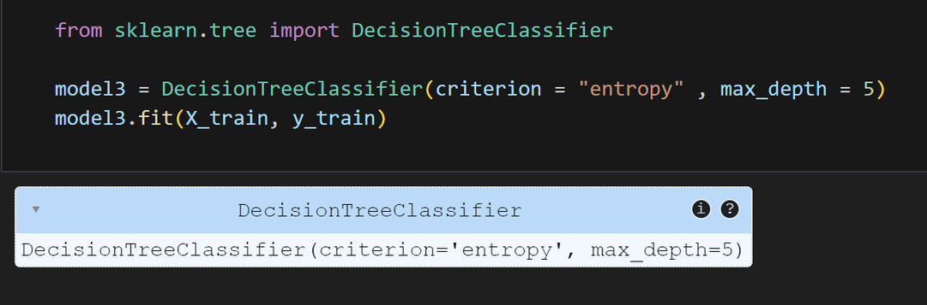
Decision Tree Modeling
This specifies the function to measure the quality of a split. The "entropy" criterion uses information gain to split the nodes. The goal is to reduce uncertainty or entropy in the data at each split.
max_depth=5: This parameter sets the maximum depth of the tree. By limiting the depth to 5, the tree is prevented from growing too complex, which helps to avoid overfitting.

Slide 25
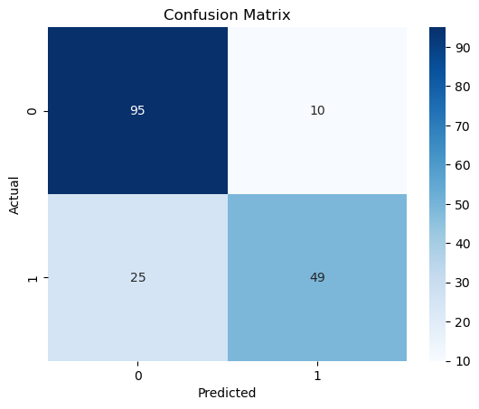
Decision Tree Confusion Matrix
True Negatives (TN) - 95: The model correctly predicted 95 passengers as non-survivors, and they indeed did not survive.
False Positives (FP) - 10: The model incorrectly predicted 10 passengers as survivors when they did not survive.
False Negatives (FN) - 25: The model incorrectly predicted 25 passengers as non-survivors when they actually survived.
True Positives (TP) - 49: The model correctly predicted 49 passengers as survivors, and they indeed survived.
0 = Not Survive
1 = Survive

Slide 26
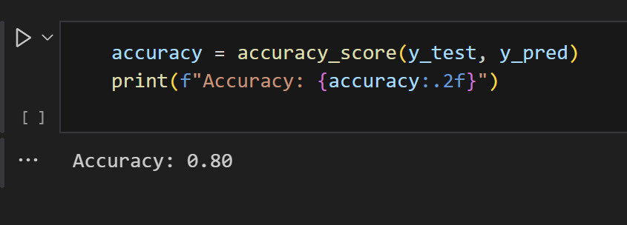
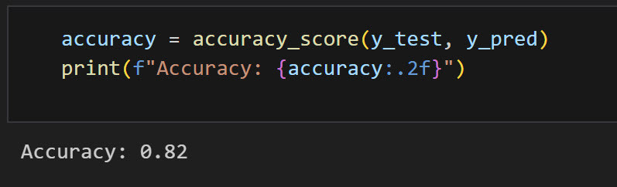
Random Forest vs Decision Tree Accuracy
Random Forest: Accuracy = 0.82 = 82%
Decision Tree: Accuracy = 0.80 = 80%

Slide 27
Conclusion

Slide 28
The Random Forest model has a slightly higher accuracy (82%) compared to the Decision Tree model (80%). This indicates that the Random Forest model performed a bit better on the test data in terms of correctly classifying the passengers.
The Random Forest model performs slightly better, with an accuracy of 82%. This suggests that it is more effective in identifying patterns in the data related to passengers' survival on the Titanic. The ensemble nature of Random Forest, which combines multiple decision trees, generally helps to improve prediction accuracy and reduce overfitting, making it more robust in this scenario.
The Decision Tree model has an accuracy of 80%, which is close to the Random Forest but slightly lower. While it performs well, it is more prone to overfitting, especially if the tree is deep. This can result in slightly lower generalization to unseen data compared to the Random Forest.

Slide 29
Thank You Very Much!
www.reallygreatsite.com

